Slide 1
SAP-2
Md. Aashikur Rahman Azim
Lecturer
CSE, BUET

Slide 2
Introduction
SAP-2 is the next step in the evaluation toward modern computers.
It includes jump instructions.

Slide 3
Bidirectional Registers
Either enable or load only active .
During load input lines active output line float
During Enable output lines active input line float.
Input and output pins are shorted.
Single set of wires(path) between register and w-bus.

Slide 4
Bidirectional Registers
LOAD
CLK
Enable
BUS

Slide 5
Architecture
Bus W
Ack
Encoder
Hexa
8
A
8
8
In Port 1
8
8
ALU
2
Flag
8
Ready
0
8
8
7
In Port 2
TEMP
Serial In
PC
16
8
B
MAR
16
8
C
16
Memory
8
MDR
8
Out Port 3
Hexa Disp
8
8
IR
8
Out Port 4
0
Serial Out
8
7
Ack
8
CON

Slide 6
Input port
Port 1 and Port 2
Port 1
Hexadecimal keyboard encoder
Sends ready signal to bit 0 of port 2 (indicates the data in port 1 is valid)
Port 2
Serial In

Slide 7
Program Counter
16 bit address
Thus can count from
PC= 0000 0000 0000 0000
PC= 1111 1111 1111 1111(FFFFH)
LOW CLR’

Slide 8
MAR and MEMORY
16- bit address to MAR (From 0000H → FFFFH)
MAR OUTPUT to RAM
Memory Capacity(?????)
2K ROM(0000H-07FFH) => Monitor Program
62K RAM(0800H-FFFFH)
ROM
0000 H
07FF H
RAM
0800 H
FFFF H

Slide 9
Memory Data Register
8-bit Register
Output setup RAM
Receives data from the bus before write operation
Data to the bus after read operation

Slide 10
Instruction Register
8-bit op code
Can accommodate 256 instruction
Only 42 instruction

Slide 11
Controller Sequencer
As usual
Generates the control words (microinstructions)
Has more hardware(larger number of instruction)
Control Word is bigger (CON)

Slide 12
Accumulator
Same as SAP-1

Slide 13
ALU and Flags
ALU: Includes both arithmetic and logical operation
4 or more control bits for determining the operation to be performed
Flag: Represent the status of the arithmetic and logical operation
Filp flops are used;
Zero Flag(Z)
Sign Flag(S)

Slide 14
Temp, B and C registers
Temporary register (TEMP)
Register B and C are used to move data during program run and accessible to programmers.

Slide 15
Output Ports
2 output ports(3 and 4)
Port 3 : Drives Hexadecimal display
Port 4: sends ACKNOWLEDGE signals used to hexadecimal encoder. (Handshaking)
Serial Out: Serial Transmission of data.

Slide 16
Microprocessor Instruction
LDA and STA
Eg:
LDA 2000H
STA 8000H

Slide 17
MVI
MVI-Move Immediate
MVI A,37H
MVI A,byte
MVI B,byte
MVI c, byte

Slide 18
Register Instruction
MOV
MOV A,B
MOV A,C
MOV B,A
MOV B,C
MOV C,A
MOV C,B

Slide 19
Register Instruction
ADD and SUB
Eg ADD B /SUB B
ADD B
ADD C
SUB B
SUB C

Slide 20
Register Instruction
INR and DCR
INR A/DCR A
INR B/DCR B
INR C/DCR C

Slide 21
Jump And Call Instruction
JMP
JMP 3000H
JM (Jump if Minus)
JZ(Jump if zero)
JNZ(Jump if not zero)

Slide 22
Jump And Call Instruction
CALL
Subroutine ????
Call is used to call the subroutine
Ret
Return back from subroutine
Program Counter contents ????
-----stored in the last two location of memory
(FFFEH and FFFFH)

Slide 23
Logic Instruction
CMA-Complement the accumulator
ANA-And the accumulator with specified register
eg ANA B
ORA- OR the accumulator with specified register
eg ORA B
XRA- XOR the accumulator with specified register
eg XRA B

Slide 24
Logic Instruction Contd.
ANI: And Immediate
Eg ANI C7H (AND accumulator with immediate data C7H)
ORI: OR immediate
Eg ORI C7H
XRI: XOR immediate
Eg XRI C7H

Slide 25
Other Instruction
OUT (OUT byte eg: OUT 03H: accumulator to designated port)
HLT
IN (Input : Enter the data from designated input port to accumulator) eg: IN 02H
NOP
RAL(Rotate the accumulator left)
A=1011 0100 After execution
A=0110 1001
RAR (Rotate the accumulator right)
A= 1011 0100
After execution
A=0101 1010

Slide 26
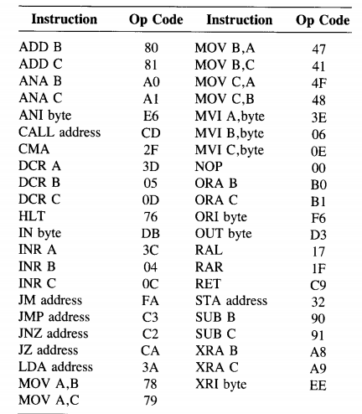
SAP-2 Op codes

Slide 27
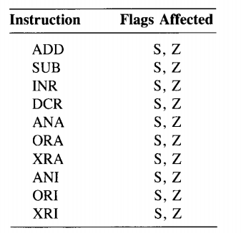
Instruction Affecting Flags

Slide 28
T-States
Fetch → 3 T-States
Execution → Different instruction requires different # of T-States
Ex: ADD B → 4
ANI byte → 7
CALL → 18
JM → 10/7

Slide 29
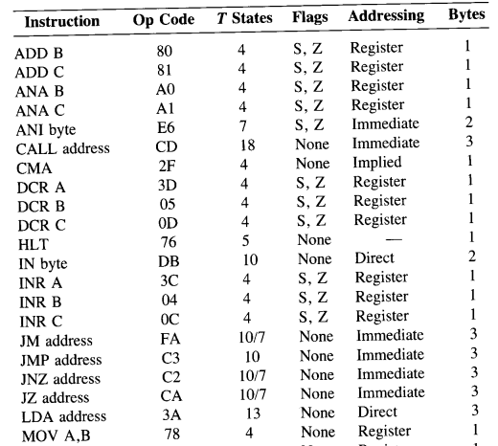
Summary 1

Slide 30
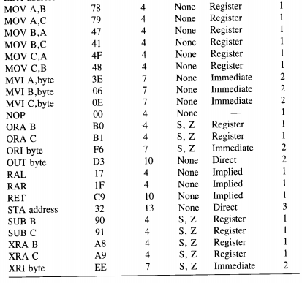
Summary 2

Slide 31
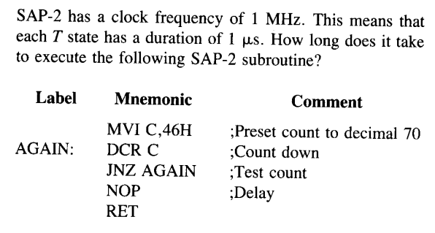
Math-1

Slide 32
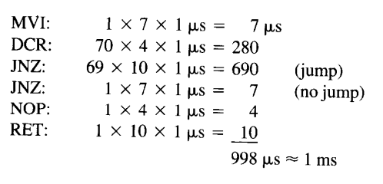
Solution of Math-1

Slide 33
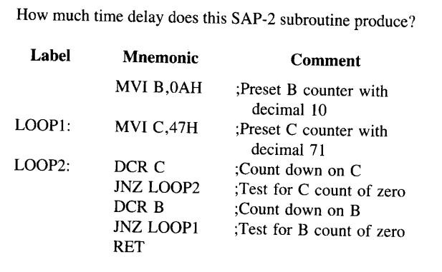
Math-2

Slide 34
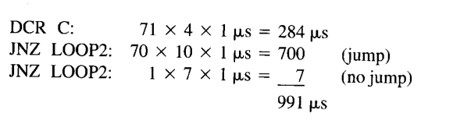
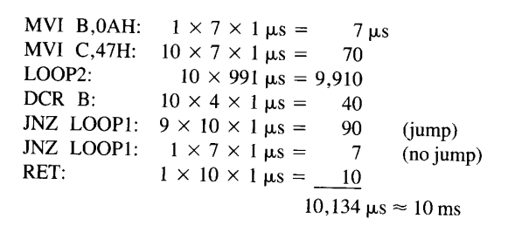
Solution of Math-2

Slide 35
Thank you

